Slide 1
Marin's Housing Shortage
Costs and Potential Solutions
Marin Economic Forum
May 4, 2018
Marin Economic Forum

Slide 2
Platinum Sponsors

Slide 3
Platinum Sponsors

Slide 4
Gold Sponsors

Slide 5
Gold Sponsors

Slide 6
Event Sponsor

Slide 7
Welcome! MEF’s Breakfast Briefing
Overview of Marin Housing
Dr. Robert Eyler, Chief Economist
Key Findings – Costs and Barriers
Jesús Guzmán, Graduate Student Consultant
Potential Solutions
Robin Sternberg, CEO
State Update/Q&A
Senator Mike McGuire

Slide 8
Marin’s Economic Housing Situation
Housing Units: Supply < Demand
Housing Demand: regional marketplace
Connections to Labor Markets
Wages
Commuting/Productivity
Talent Attraction
An issue of Equity also: homeownership builds wealth
As new units built, need to consider mix

Slide 9
Workforce Housing: A Continuum
Workforce Housing/Affordability covers all Income Levels
Subsidized
Below-Market Rate
Market Rate

Slide 10
The Quadlemma: Seeking Utopia
Marin County
Low traffic
Vibrant Job Market for all
Slow growth of housing stock
Low density

Slide 11
Housing Forecast Considerations
Marin County to grow 4.86% in 2018, 3.8% in Sonoma
Interest rates: +150-200 bp in the next 24 months?
Fires to affect regional market for years
Expect cost of living pressure otherwise
No recession forecasted for CA to 2021 (WOW!)

Slide 12
1,134 people (net) moved to Marin in 2017
Source: California Dept of Finance

Slide 13
Population Forecast
Source: California Dept of Finance

Slide 14
Job Growth Versus Population, 2017 and 2030
Source: California Dept of Finance

Slide 15
New Housing Units Since 2011 (Only 87 units added in 2016!)
County | 2011 | 2012 | 2013 | 2014 | 2015 | 2016
Marin | 110 | 106 | 117 | 150 | 106 | 87
Alameda | 1,322 | 2,425 | 2,474 | 2,287 | 2,427 | 3,274
Contra Costa | 1,436 | 1,287 | 1,716 | 1,833 | 2,122 | 2,413
Napa | 107 | 87 | 79 | 104 | 113 | 187
San Francisco | 299 | 1,279 | 2,377 | 3,514 | 2,848 | 5,114
San Mateo | 720 | 319 | 1,055 | 1,080 | 1,424 | 1,153
Santa Clara | 3,605 | 2,698 | 5,245 | 7,316 | 5,353 | 4,515
Solano | 420 | 499 | 671 | 658 | 935 | 1,180
Sonoma | 525 | 502 | 672 | 365 | 504 | 647
Source: California Dept of Finance

Slide 16
Housing Stock: Units and People
Marin
Source: California Dept of Finance

Slide 17
Housing Stock: Units and Jobs
Source: California Dept of Finance

Slide 18
Population to Housing Stock Ratio
Source: California Dept of Finance

Slide 19
Growth of Housing Prices (All Homes) (Up 100% since 2009!)
Source: Zillow Research
Source: Zillow Research

Slide 20
Marin Rental Markets out the Roof 2009-2018, $/month, 2009 $
Source: Zillow Research

Slide 21
Wages – Marin 111% higher than CA average, 2017
Category | CA | Marin/ CA | Marin County | Solano | Napa | San Francisco | Sonoma
Total all occupations | $34.43 | 111% | $38.10 | 84% | 81% | 128% | 81%
Healthcare Practitioners and Technical | $57.90 | 118% | $65.60 | 96% | 88% | 105% | 85%
Life, Physical, and Social Science | $50.21 | 112% | $57.84 | 103% | 100% | 106% | 90%
Computer and Mathematical | $63.48 | 101% | $55.32 | 87% | 82% | 109% | 88%
Architecture and Engineering | $60.24 | 92% | $53.62 | 97% | 95% | 115% | 101%
Business and Financial Operations | $48.83 | 121% | $47.46 | 80% | 84% | 99% | 75%
Protective Service | $40.93 | 107% | $42.61 | 97% | 83% | 102% | 104%
Community and Social Services | $34.28 | 96% | $35.53 | 108% | 119% | 111% | 105%
Education, Training, and Library | $38.90 | 93% | $32.05 | 88% | 103% | 112% | 100%
Arts, Design, Entertainment, Sports, and Media | $43.85 | 109% | $28.99 | 61% | 74% | 102% | 76%
Healthcare Support | $21.47 | 119% | $24.16 | 94% | 86% | 105% | 98%
Food Preparation and Serving-Related | $14.50 | 108% | $14.10 | 90% | 110% | 114% | 103%
Source: California EDD

Slide 22
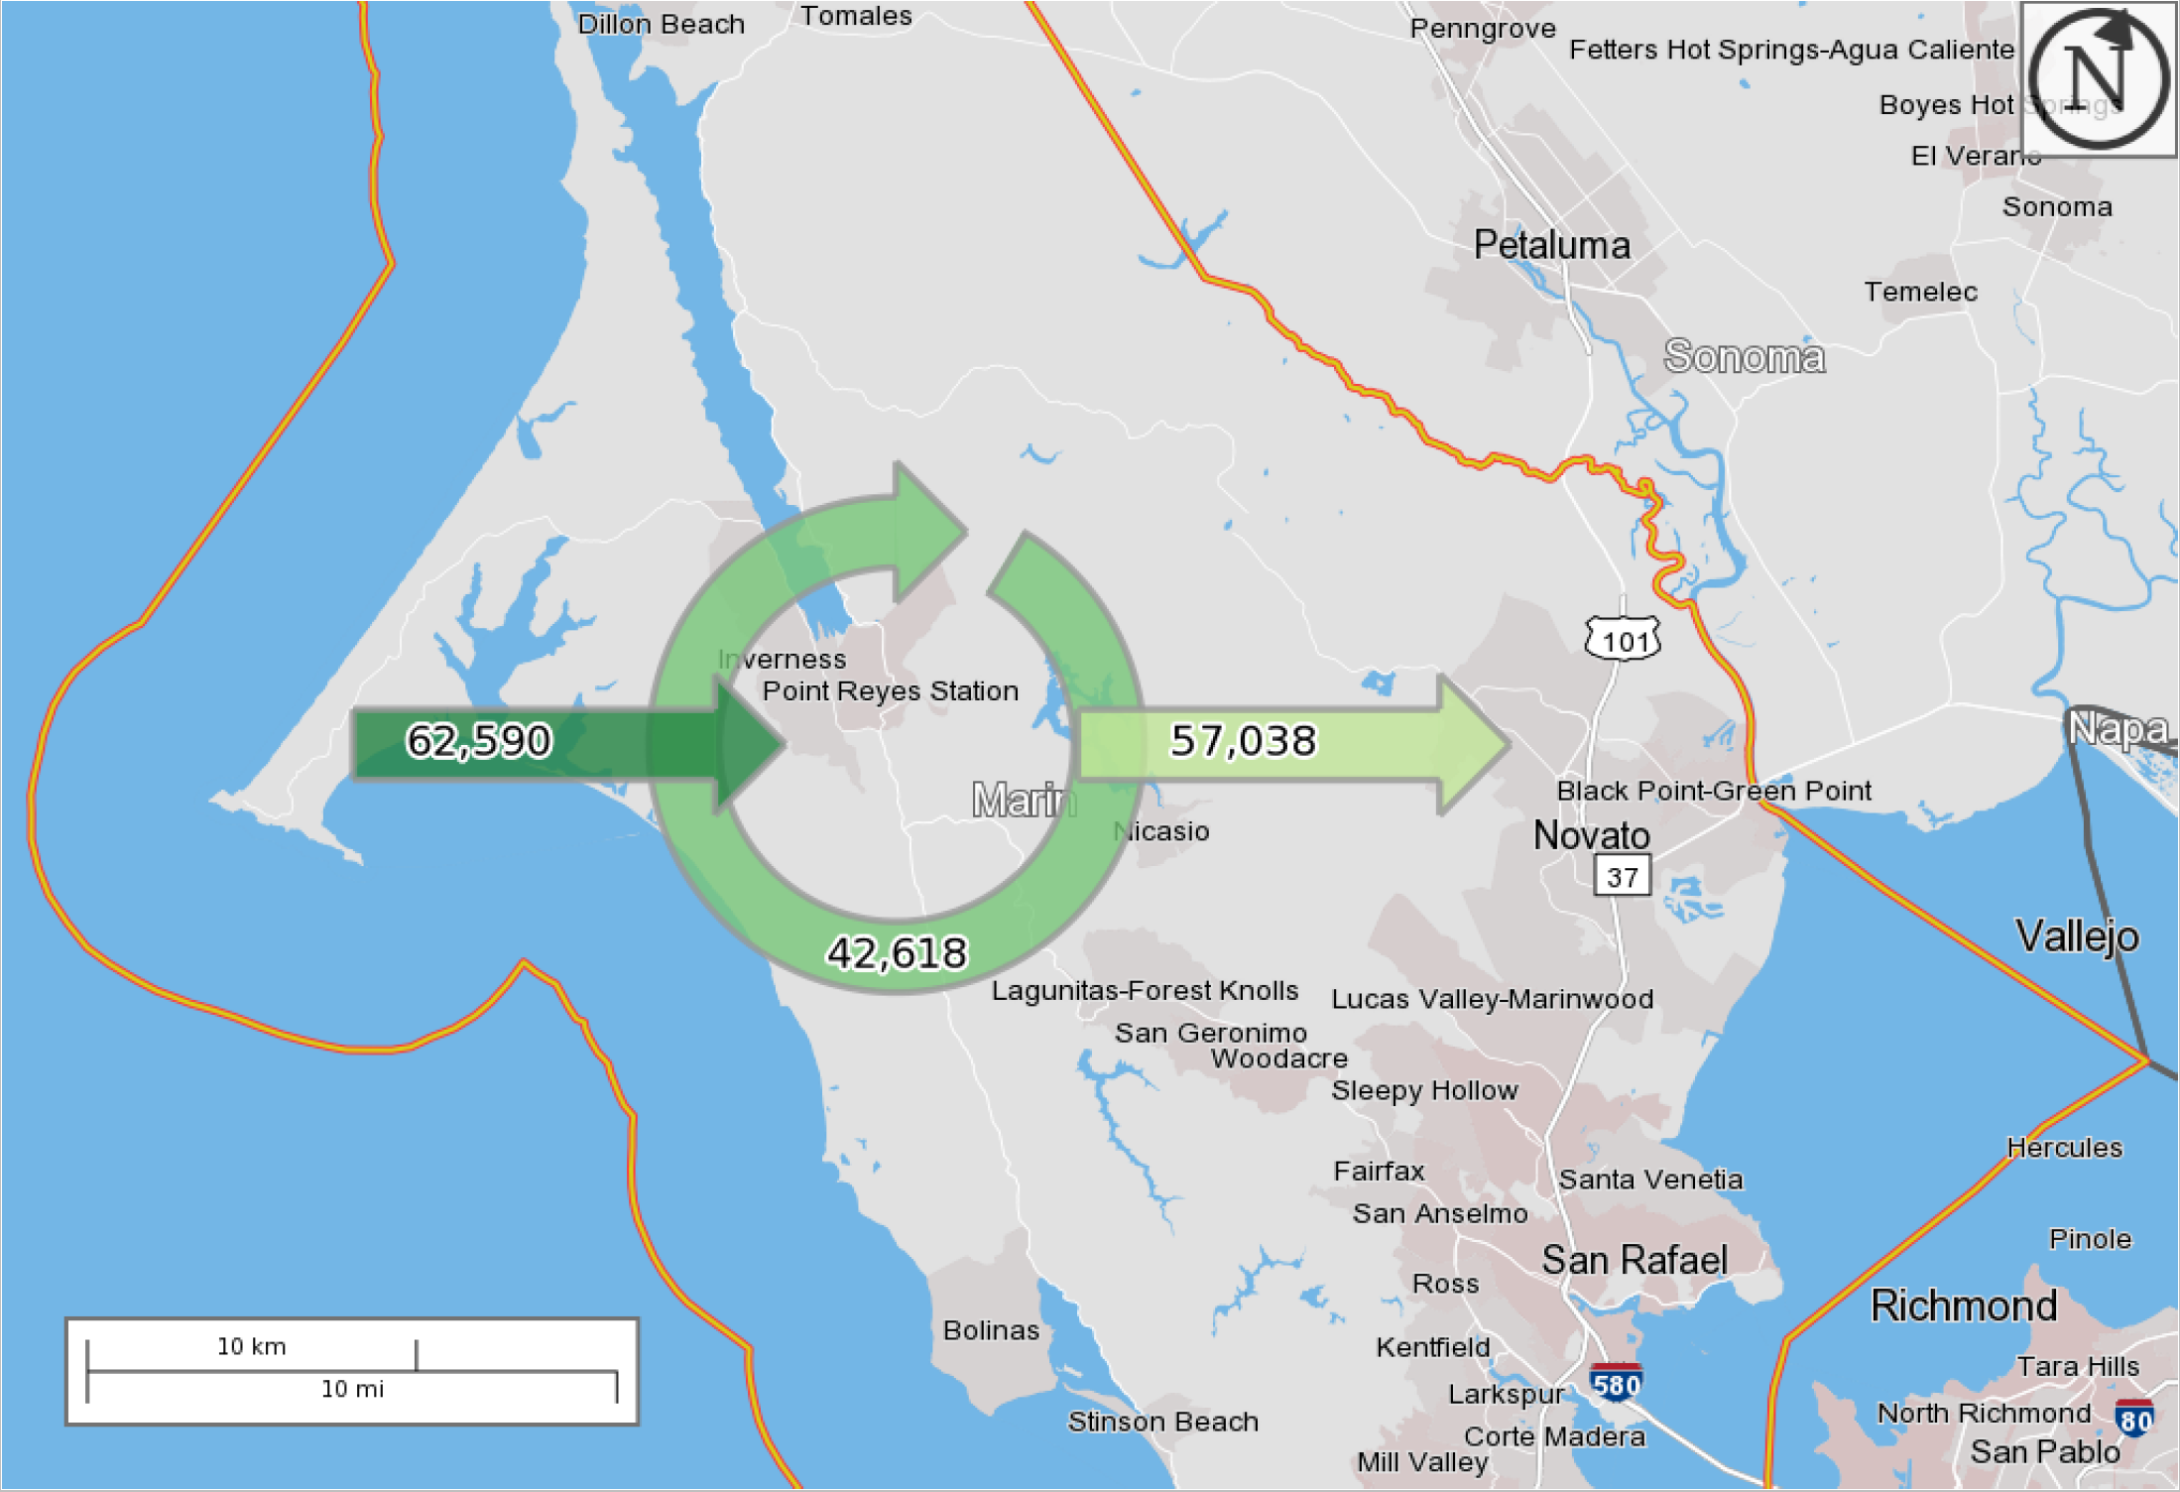
Rising Commuting and Retention problems (Commuting inbound is rising faster than outbound)
2008
2015
Source: Census Bureau

Slide 23
We need Bold Housing Steps (Now)
Do we need more housing with a wide mix? Yes
Is the cost of construction rising? Yes
Are interest rates going to remain this low forever? No
Is there a cost to the housing market status quo? Yes
Is it impacting the environment and quality of life? Yes
Is it creating an equity problem? Yes

Slide 24
DATA
Economic Data Sources
Integrated Public Use Microdata Series
American Community Survey 5-year estimates (2012 – 2016)
American Community Survey 1-year estimates (2011)
Association of Bay Area Governments & Metropolitan Transportation Commission
CA Department of Finance
CA Economic Development Department
U.S. Census Building Permits Survey
U.S. Bureau of Labor Statistics
Interviews and Focus Groups with
30+ Organization Engaged
Construction/Real Estate Leaders
Commercial Builders
Property Owners
Affordable Housing Developers
Affordable Housing Advocates
Businesses/Employers
City/County Administrators/Planners
County Elected Officials
YIMBYs
Youth Leadership
Nonprofits/Community Orgs
Senior Housing Representatives

Slide 25
Key Questions
What is the housing shortage costing Marin County?
&
Who is paying the price?

Slide 26
DATA
Economic Data Sources
Integrated Public Use Microdata Series
American Community Survey 5-year estimates (2012 – 2016)
American Community Survey 1-year estimates (2011)
Association of Bay Area Governments & Metropolitan Transportation Commission
CA Department of Finance
CA Economic Development Department
U.S. Census Building Permits Survey
U.S. Bureau of Labor Statistics
Interviews and Focus Groups with
30+ Organization Engaged
Construction/Real Estate Leaders
Commercial Builders
Property Owners
Affordable Housing Developers
Affordable Housing Advocates
Businesses/Employers
City/County Administrators/Planners
County Elected Officials
YIMBYs
Youth Leadership
Nonprofits/Community Orgs
Senior Housing Representatives

Slide 27
$500+ Million a Year

Slide 28
The Basic Math
Lost Consumer Spending $370 million
2. Latent Construction Activity $130 million
$370MM
$130MM
$500MM

Slide 29
Lost Consumer Spending = $366 Million/yr.
$366 million
84.5% from lower-income households
15.5% from moderate income households

Slide 30
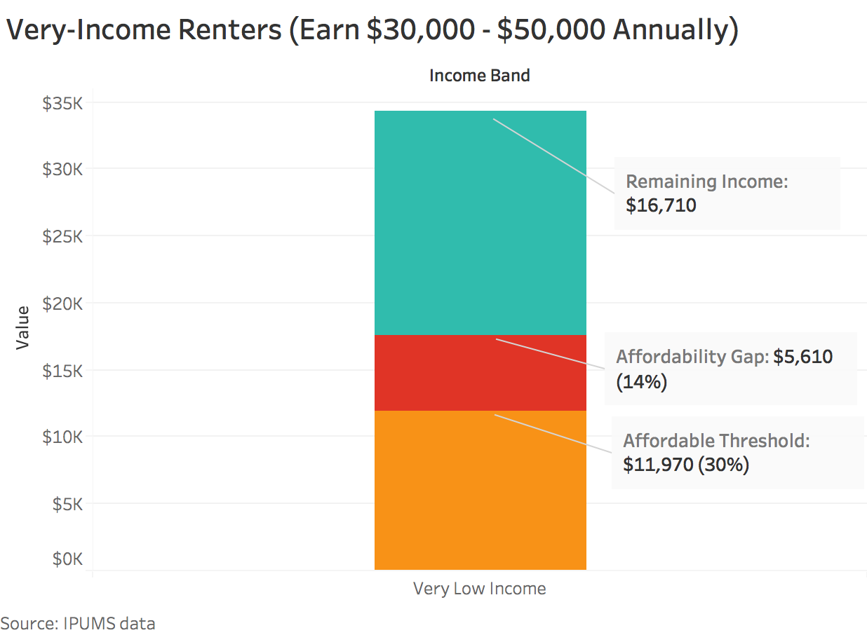
Very-Low Income Renters (Annual Income Between $30 - $50,000)

Slide 31
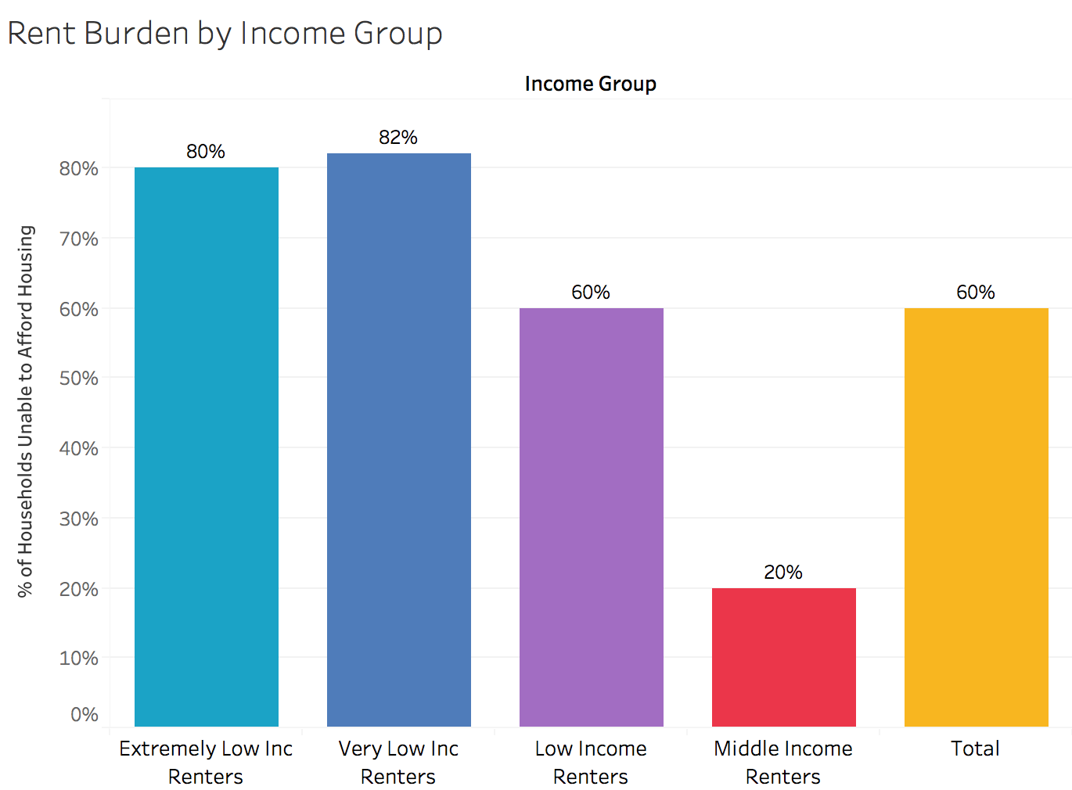

Slide 32
Affordability Gap
Rental housing burden in aggregate is
$168 million annually
Homeowners’ affordability gap in aggregate is $209 million annually
Severe affordability gap (+50% household income spent on housing) for Marin households that rent is $86 million annually

Slide 33
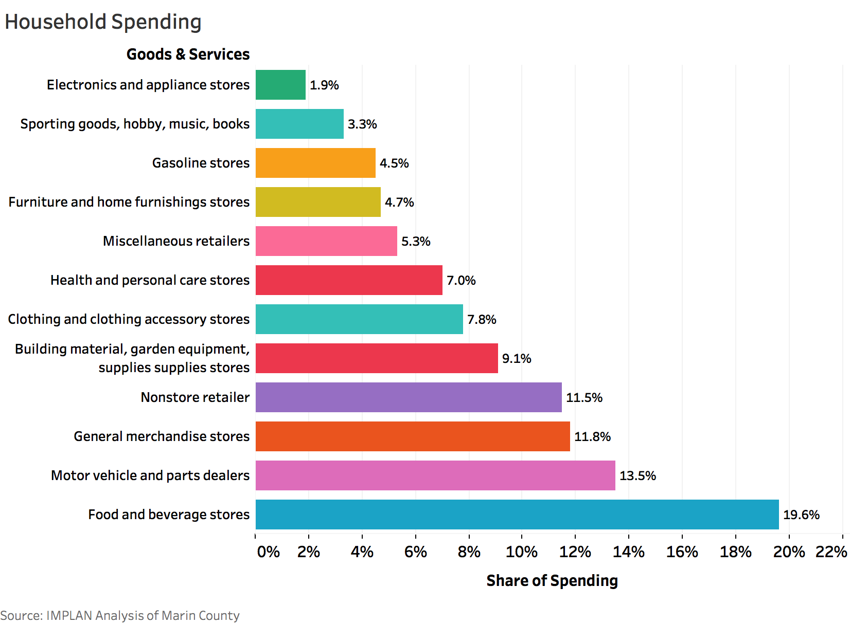

Slide 34
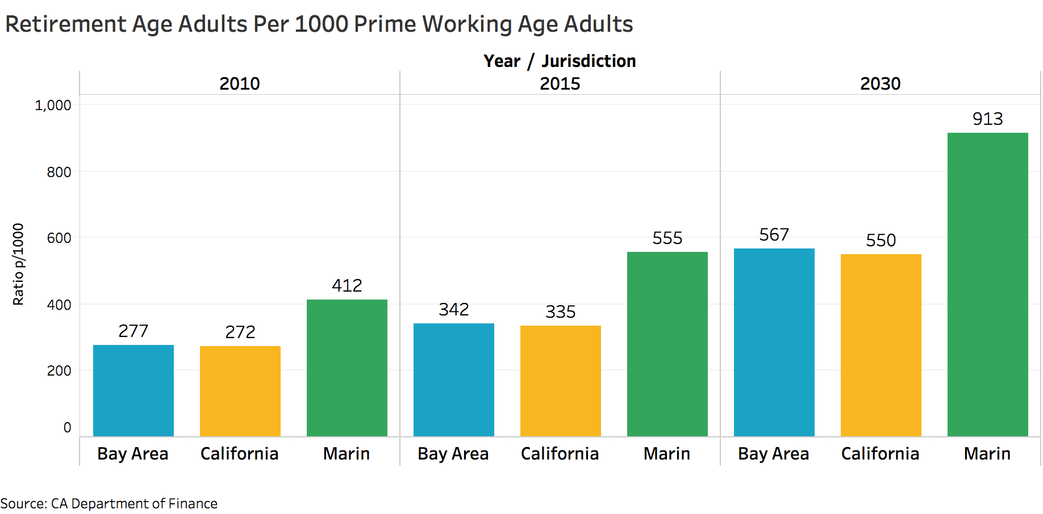
Marin’s Aging Population = Declining Future Consumer Spending and Economic Growth

Slide 35
Marin County Latent Construction Activity
$94 - $128 million annually
In total, $735 million to $1 billion from 2015 - 2023

Slide 36
Methodology: Lost Economic Activity from Latent Construction
Housing Production
Value of Construction
Impact on the Economy

Slide 37
62% Marin County's workforce commutes in daily (70,000)
8% On average commute over an hour
Commuting

Slide 38
1. Reduced Productivity from Commuting $7.1 million lost from 1+ hour commuters 2. Increase in Turnover Cost 50% of CA companies report losing a candidate or having to pay more because of Housing 3. Talent Replacement Cost The typical median cost is about 21% of an employee’s annual salary
Employer Related Costs
Turnover costs per employee to a retail business would be avg. $9,205

Slide 39
Housing Shortage Disproportionately Impacting Minorities
No Way Up!

Slide 40
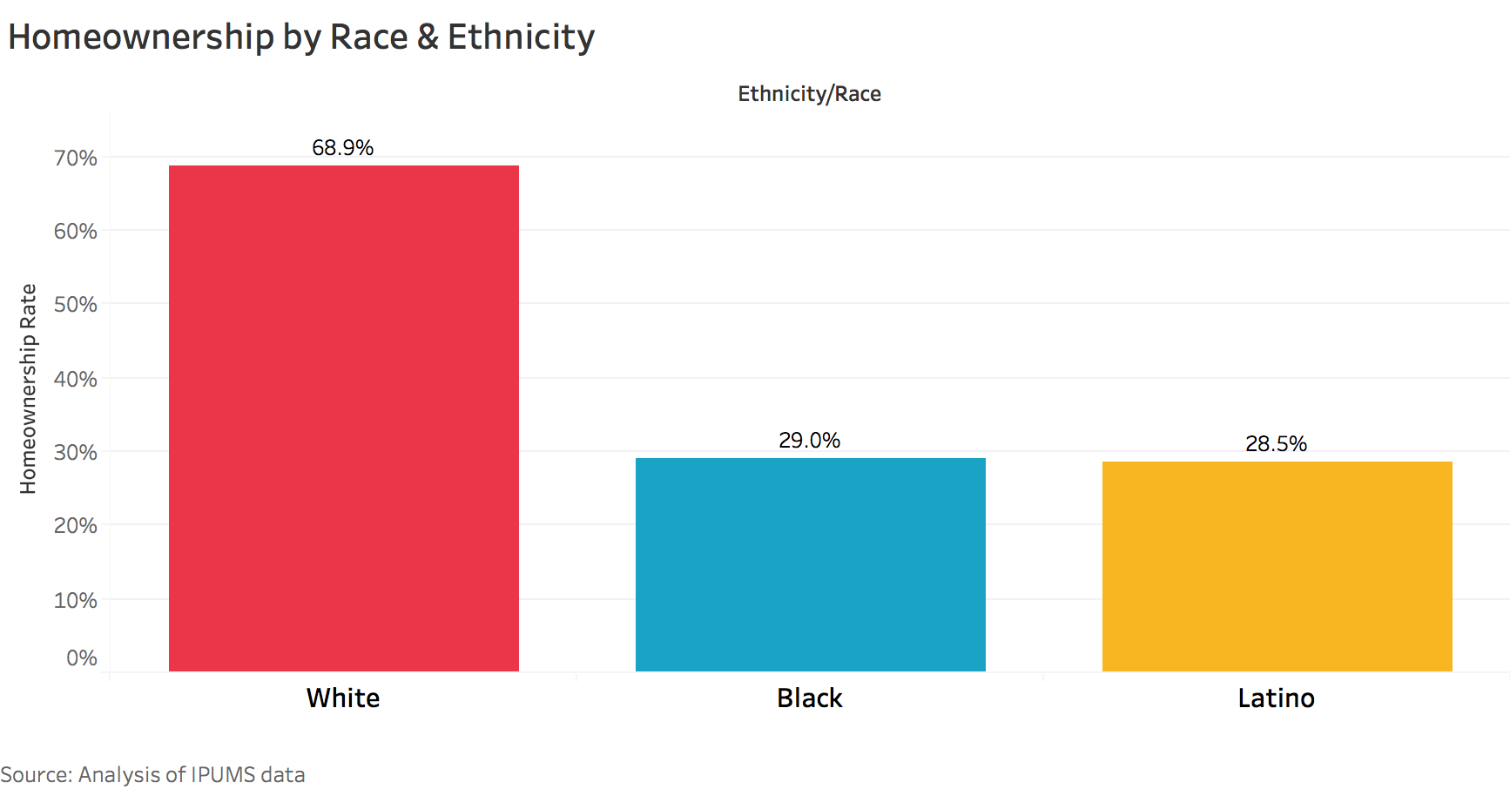
Far Less Marin Minorities Own Homes (unable to build wealth and falling further behind)

Slide 41
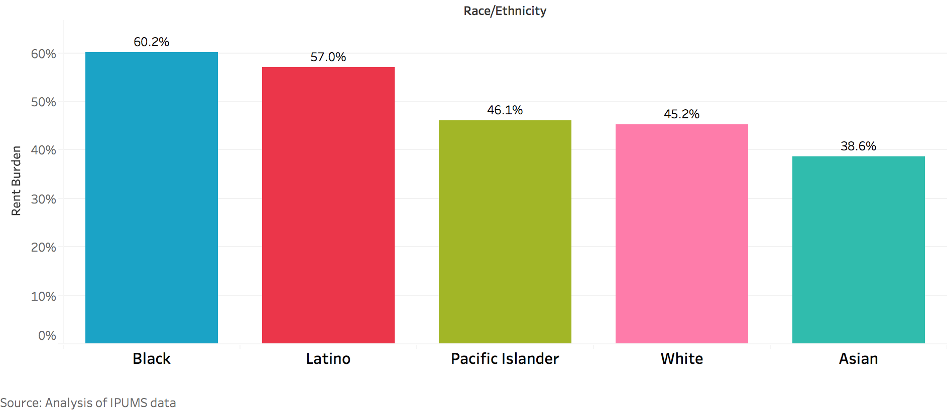
Marin Minority Renters are Struggling with a High-Housing Burden

Slide 42
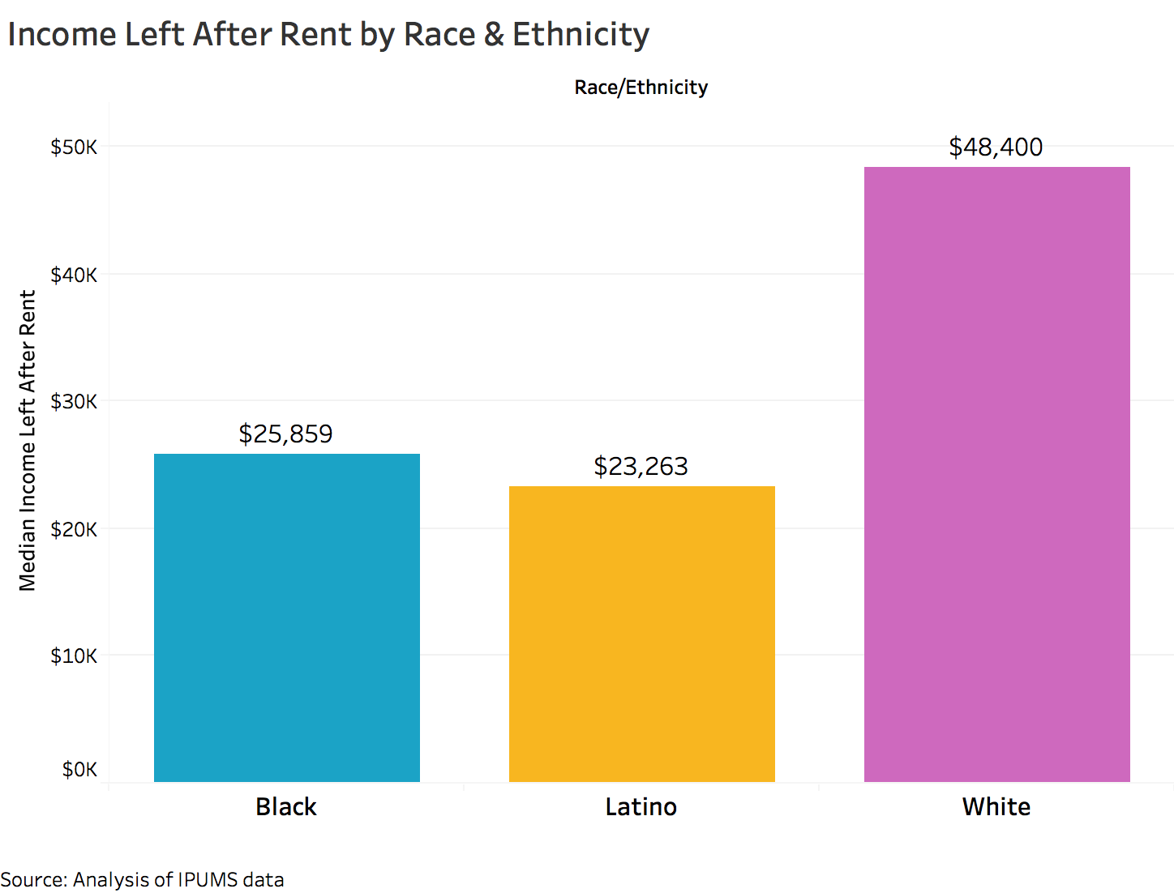
African-American & Latino households have significantly Less Income Post-rent

Slide 43
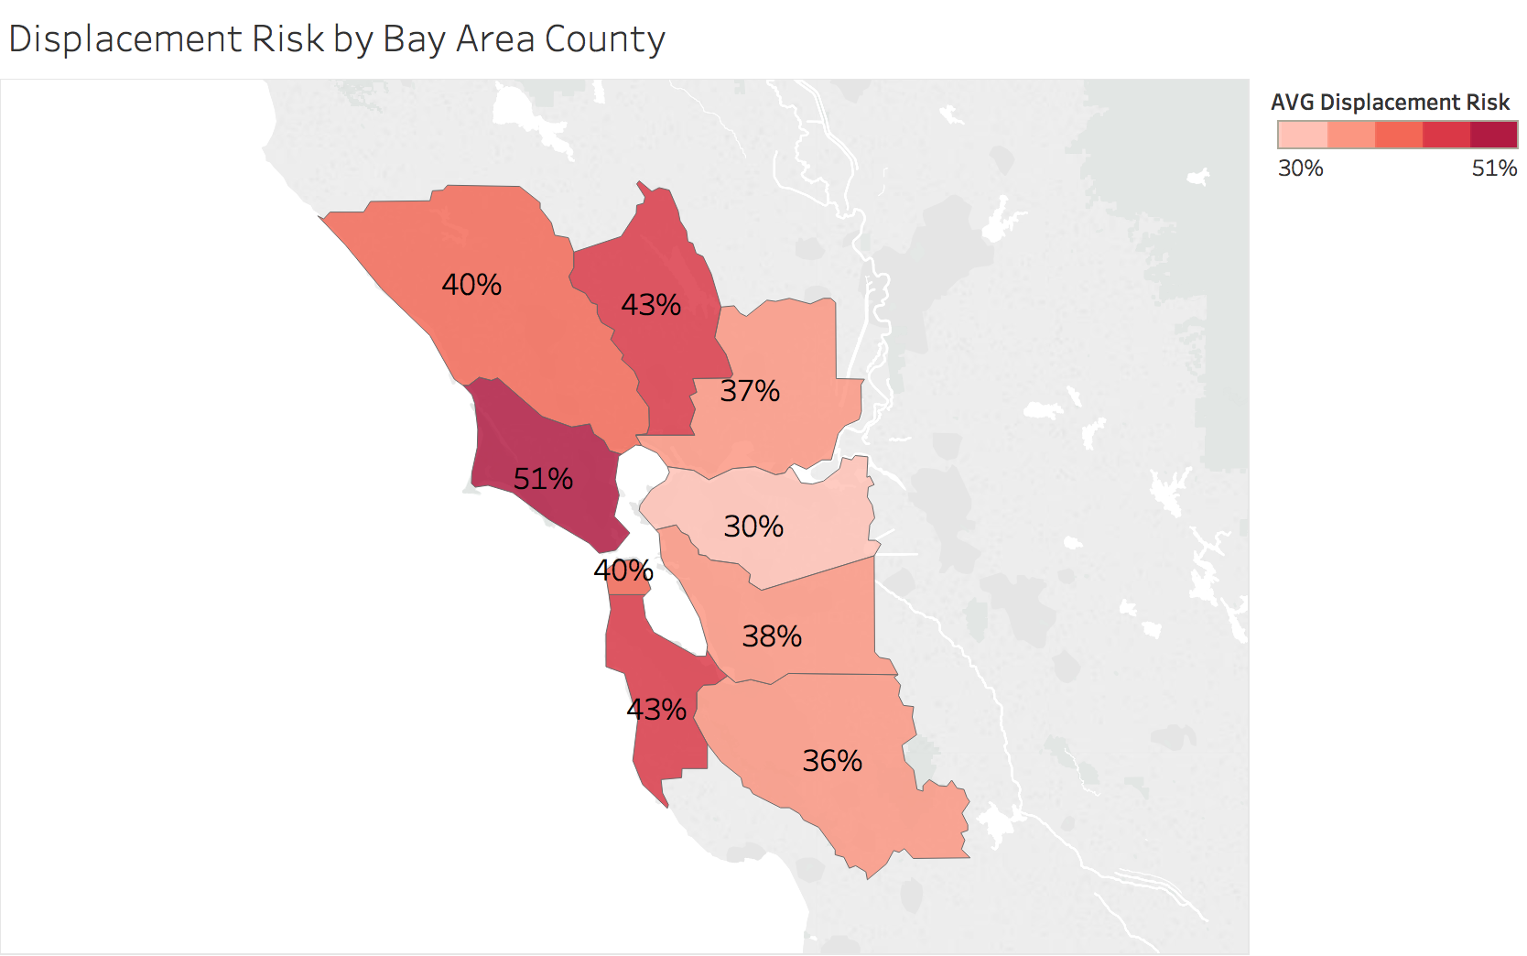
Low Income Displacement Risk Highest in Bay Area

Slide 44
What we heard about the barriers?
Prohibitive costs of Permitting (avg. 11.5 months among highest in nation) = Uncertainty and High Project Costs
Discretionary approach to Permitting Process
Hyper-local Public Opposition
Political Realities of Board of Supervisors, Mayors, City Councils
Lack of Construction Workers
No Integrated County-wide Regional Planning

Slide 45
MARIN'S HOUSING SHORTAGE POTENTIAL SOLUTIONS

Slide 46
What are the Goals? Alignment of focus and investment among Public/Private/Nonprofit Leadership
Increase Housing Supply
Increase Acceptance of Sustainable Growth
More Workers to Live near Jobs
Build Wealth for Low Income Residents
Have a Plan for the Future

Slide 47
Strategic Recommendation 1 Create a long-range Economic Development and Housing plan with strategic actions and accountablilty
Cities and County Collaborate to map In-Fill Areas, Underutilized land, Developable and Re-Developable sites
Create an Enhanced Infrastructure Finance District (EIFD) to help fund projects
Other State and Federal Funding for Economic Development and Housing

Slide 48
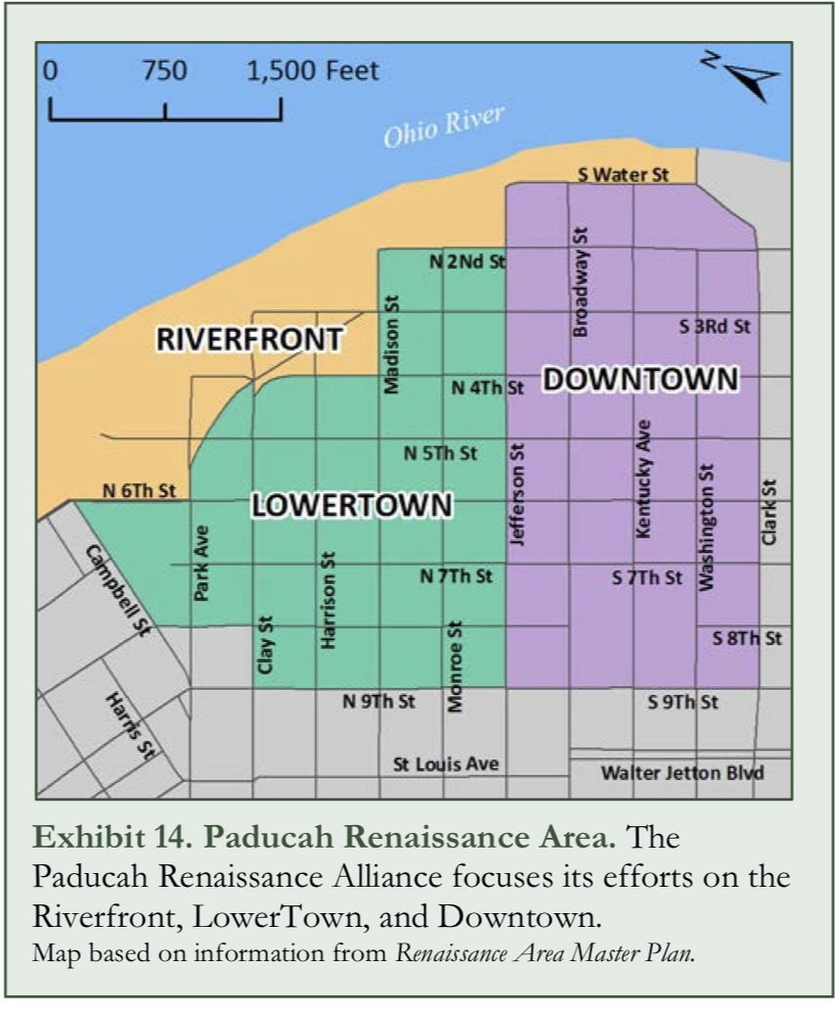
Update and Integrate County and City plans for a Future Vision

Slide 49
What is an Enhanced Infrastructure Finance District (EIFD)?
A workaround for Redevelopment $$ lost in 2012
Refined 2015 CA laws allow cities, counties, and special districts to form EIFDs and issue TIF bonds
Taxes paid from property improvements are a municipal finance tool providing new revenue sources
A wide range of types of projects that can be funded with EIFDs

Slide 50
EIFD Allowable Projects
Roads, Highways, Bridges
Parking
Transit Stations
Sewage/Water facilities
Flood control and drainage
Solid Waste Disposal
Parks and Libraries
Child Care Facilities
Brownfield Restoration
Environmental Mitigation
Military Reuse Projects
Affordable Housing
Private Industrial Buildings
Transit Oriented Development
Projects with Sustainable Community Strategies

Slide 51
West Sacramento EIFD = net $143 million property tax to City
Improve Waterfront, Transportation, Mixed use with Affordable and Market Rate Housing, Enhance Public Facilities for Residents, Businesses and Visitors
Will create an $1.1 Billion in Public Facilities Improvements
$2 Billion Total Revenues - $1.85 in expenditures = $143 Million Net Revenue

Slide 52
Los Angeles River Revitalization EIFD
11-mile segment
of the 48-mile L.A. River
Neighborhood Improvement Housing
Commercial
Parks and Recreational
Est. $40 million EIFD funding

Slide 53
Identify and Bundle Short and Long Term project needs across the County
Marin City Development San Rafael Transit Center
Civic Center
Coastal Rehabilitation Farmers Market Project MarinShip
Homeless Shelters West Marin Infrastructure
101 Beautification Bike Lanes
Novato Theater San Geronimo Golf Course Workforce Housing!!!!!

Slide 54
Strategic Recommendation 2 Motivate and Support Housing Developers
Streamline the Permit Process - Create a Concierge Culture
Proactive/paid for EIRs and Shovel Ready sites
Attract and Train Construction workers
Education Pipeline
Construction Worker Housing

Slide 55
Streamlining – Permitting One-Stop Reform the way we do Business
Reduce Uncertainty and Time required to get a permit
Provide Oversight, Transparency and Continuous Improvement
Communicate of Outcomes

Slide 56
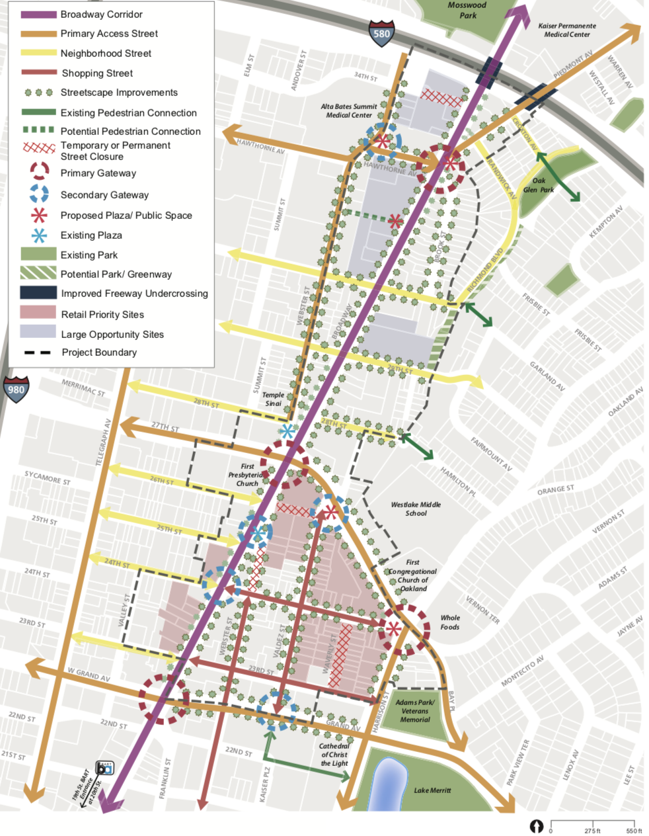
Proactive EIR (Environmental Impact Report)
Broadway/Valdez

Slide 57
Train a Pipeline of Construction Workers
Sonoma County Adult Education Partnership Model
Sonoma County Adult Education
Santa Rosa Junior College
English Secondary Language element
Painters Labor Union
8-Week Program
Funded Public/Private (Free, Childcare, Support Services)

Slide 58
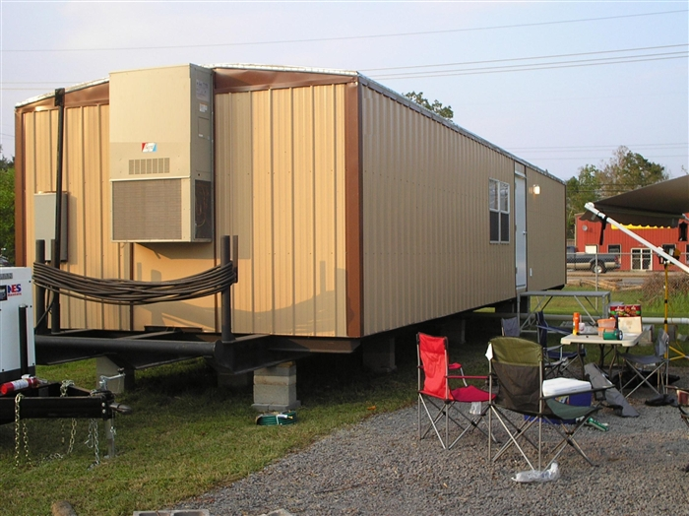
Get Creative on Construction Worker Housing
In the Works:
City of Santa Rosa/Church Partnership
Church Property offering to allow temporary Accessory Dwelling Units on property for Construction Workers

Slide 59
Strategic Recommendation 3 Build Equity for Low Income Populations
Facilitate Low Income Home Purchases
Establish a Public Project Disadvantaged Business Program
Minority Business startup Microloans Program

Slide 60
Facilitate Minority Home Purchases
Consider down payment assistance, grants, subsidies, homeownership voucher, no/low cost loans, soft second mortgages
Financial Literacy - Critical
Credit Counseling – also Critical

Slide 61
DBE Success - Minnesota Vikings Stadium “The People’s Stadium”
MINNESOTA STADIUM CONSTRUCTION SERVICES AGREEMENT EQUITY PLAN
Workforce Goals Actual
32% Minority 37%
6% Women 9%
Targeted Business Goals Actual
11% WBE 15%
9% MBE 12%
Veterans Inclusion 1%

Slide 62
Encourage Minority Start ups (especially in Construction)
Community Group Involvement
SBDC – Entrepreneur Workshops
Microloan Funds
Technical Support - Critical
Mentoring

Slide 63
Strategic Recommendation 4 Shift Culture, Eliminate fear
Where are we now? – Polling
Communications/Education/Awareness Campaign
Dispel Myths/MisInformation/Fear

Slide 64
Polling
Collect Opinion Data from the whole community, not just the vocal few

Slide 65
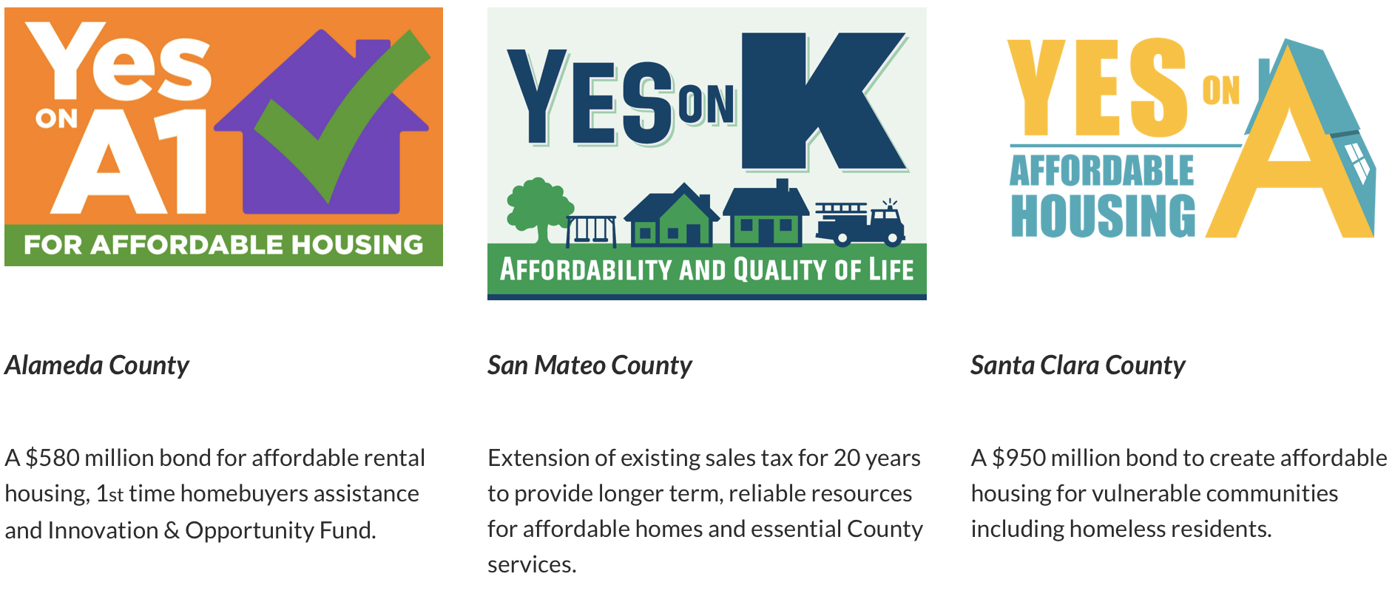

Slide 66
Education/Persuasion Campaign
Dispel Myths and Promote Benefits
Lift up new voices from (Business, Senior Housing, Millenials, Minorities)
Undertake targeted, focused campaigns designed to produce tangible results to increase investment in affordable homes
Provide Evidence and Support for Political Leaders

Slide 67
Let’s Achieve our Goals, Together Alignment among Private/Public/Nonprofit
Increase Housing Supply
Increase Acceptance of Sustainable Growth
More Workers to Live near Jobs
Build Wealth for Low Income Residents
Have a Plan for the Future

Slide 68
Next Steps – Who’s In?
County/City steering committee, Inventory needs
Philanthropy, Business and Community Partnership key
Expand Coalition, involve Private Sector, Developers
Endorsement of Elected Officials
Stay Resolute – focus on Economic Growth & Equity
Source Funding to conduct a serious Education/Persuasion Campaign

