Slide 1
Forecasting the Future Marin County’s Economy to 2020: What Can We See Well? San Rafael, CA January 29, 2020
Robert Eyler, PhD
Chief Economist, Marin Economic Forum
eyler@marineconomicforum.org
Notes:
PSPS Outcomes: can we do one slide?
Transportation? = LEHD
Building permits activity
Housing inventory
Rental prices
Commercial RE

Slide 2
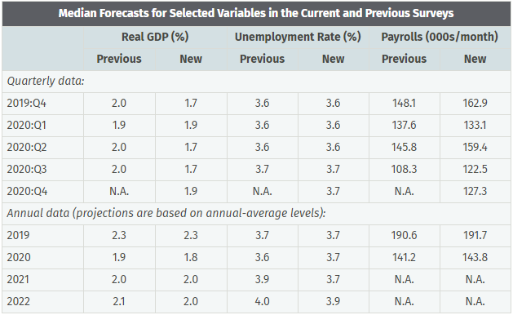
What do the professionals say?
Source: Philadelphia Federal Reserve Branch
Notes:
Quick overview of how macro works for macroeconomists

Slide 3
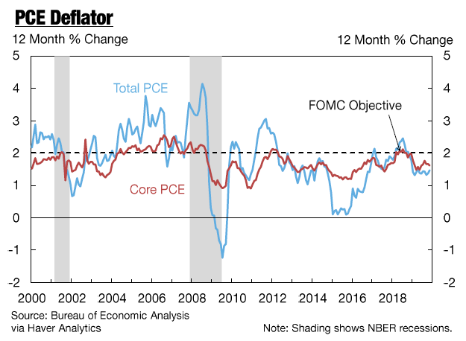
Prices: FED Watching, to December 2019

Slide 4
Yield Curve (10y-3m) and Effective FFR, % Monthly: Jan 1985 – November 2019
Source: Federal Reserve Board, Shade = Recession

Slide 5
Equity Markets: S&P 500 (Weekly and 6 mth MA),
Shaded dates = recession, Jan 2002 – Jan 2020
Source: Federal Reserve Board
Shaded Area = Recession (NBER)

Slide 6
Percent of Balance 90+ Days Delinquent by Loan Type, 2003-19, % of Balance, Quarterly to Q3 2019

Slide 7
National Economy as Context for Marin County
Growth slowing in 2020, may flirt with technical recession by 2021
FED likely on pause until summer 2020
Global rates also pressured to drop again, US equity market demanded as are bonds
2020 elections: Trump likely to win given history, electoral college and economy
If impeachment happens…many bets off
Otherwise, watch trade and other events

Slide 8
Marin County and California

Slide 9
Leading Indicators, CA and US

Slide 10
Initial Unemployment Claims, SA Index 100 = Jan 2002, 2002 to Nov 2019
Source: California EDD

Slide 11
GDP at County Level, Percentage Change Annually, 2008-18, 2012$
Source: Bureau of Economic Analysis (www.bea.gov)

Slide 12
Comparisons: Non-Farm 12-month % Change
Selected Areas, Seasonally Adjusted, Jan 1991 – Nov 2019
Source: California EDD

Slide 13
Housing Prices, Marin County, Current Dollars Jan 2001 – Dec 2019
Forecast for next
12 months = +2.8%
Source: Zillow Research + CA Dept of Finance
Notes:
Add SF also

Slide 14
Building Permits, New Units, Marin, Napa, Sonoma Counties, Previous 12-month totals, 2008 to November 2019
Source: Census Bureau

Slide 15
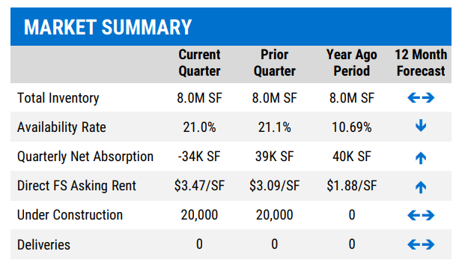
Commercial RE in Marin County, Q3 2019
Source: NKF Commercial RE Research

Slide 16
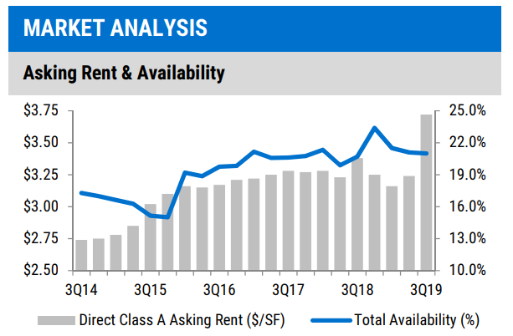
Comm RE in Marin County (cont.)
Source: NKF Commercial RE Research

Slide 17
Population change, County Fiscal Year, 2010-11 to 2018-19, Number of People (% Change for CA)
Source: CA Dept of Finance

Slide 18
Population Components, Marin County, 2010-11 to 2018-19 Fiscal Years, Number of People
Source: CA Dept of Finance

Slide 19
Business Retention and Expansion (BRE)

Slide 20
Number of Payroll Businesses, Marin County, 2008 Q1 to 2019 Q1 Annual
Source: California EDD

Slide 21
2019 Business Mix by Employment
Source: California EDD

Slide 22
Sizes of Businesses, Marin County, 2018
Source: Census Bureau

Slide 23
Looking Forward
2020 Elections
Plenty on CA ballot, including split roll for Prop 13
President (statistically) likely to be re-elected, short of an event or major economic downturn
Interest rates
Watching household balance sheets closely
Watching corporate debt levels: highest % of GDP in history
Challenges/Opportunities for Marin County
BRE Initiatives: we need to support our businesses
Competitive downtowns: homeless in the mix
Shifting retail landscape a long-term issue
Workforce development pressures: Supply and Demand

Slide 24
Questions?
Thanks!
eyler@marineconomicforum.org @bobby7007
www.marineconomicforum.org

